Slide 1

Procesamiento de Imágenes
Domingo Mery
Departamento de Ciencia de la Computación
Escuela de Ingeniería
Universidad Católica de Chile
Image Restoration - Examples
[ Capítulo 6 ]

Slide 2
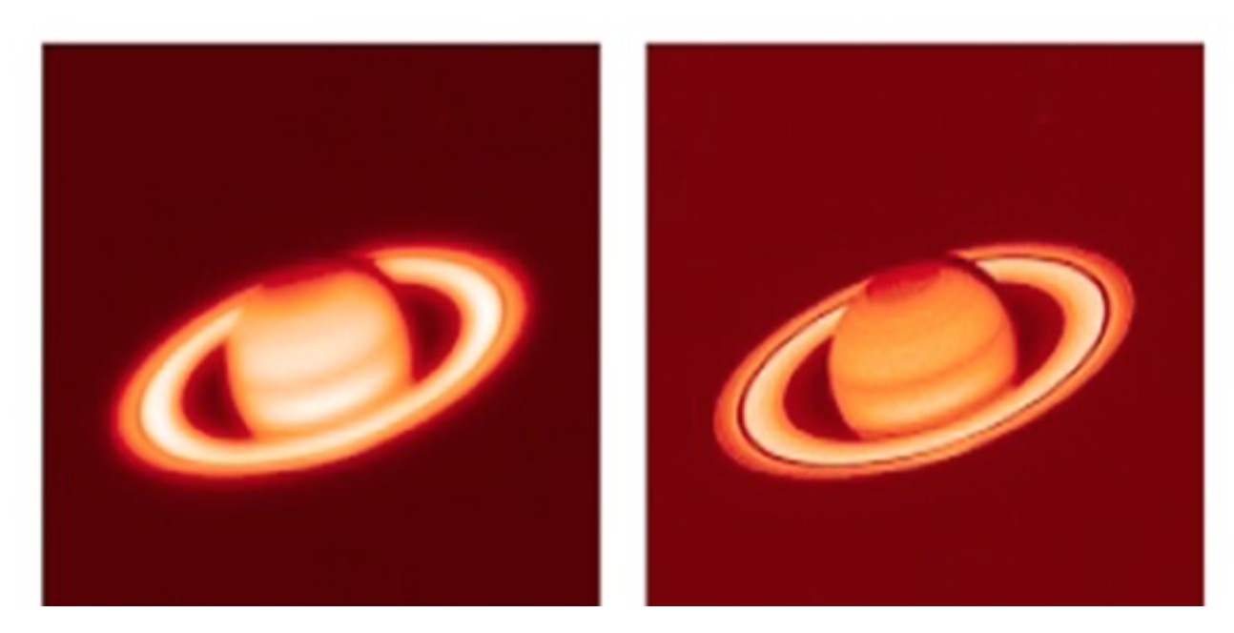

Slide 3
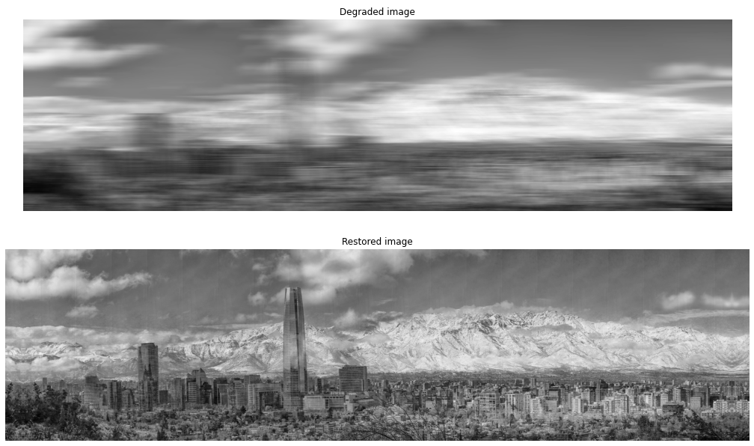

Slide 4


Slide 5
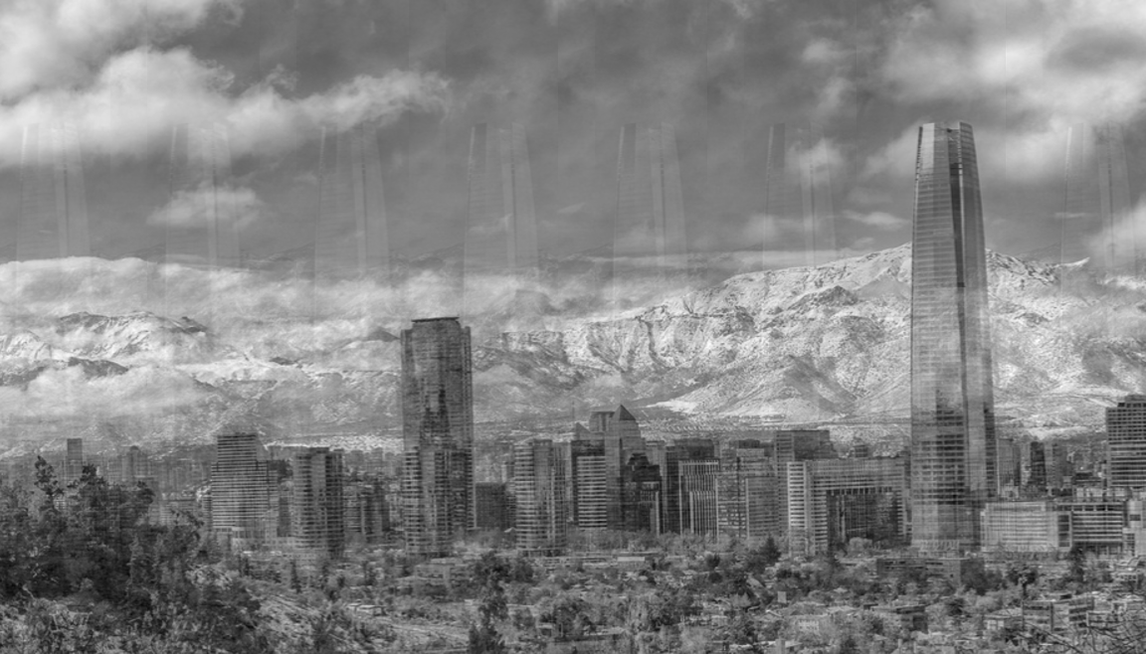

Slide 6
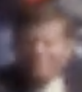
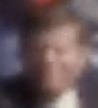







Who is he?
https://www.youtube.com/watch?v=PfSXkfV_mhA
https://www.youtube.com/watch?v=iU83R7rpXQY

Slide 7
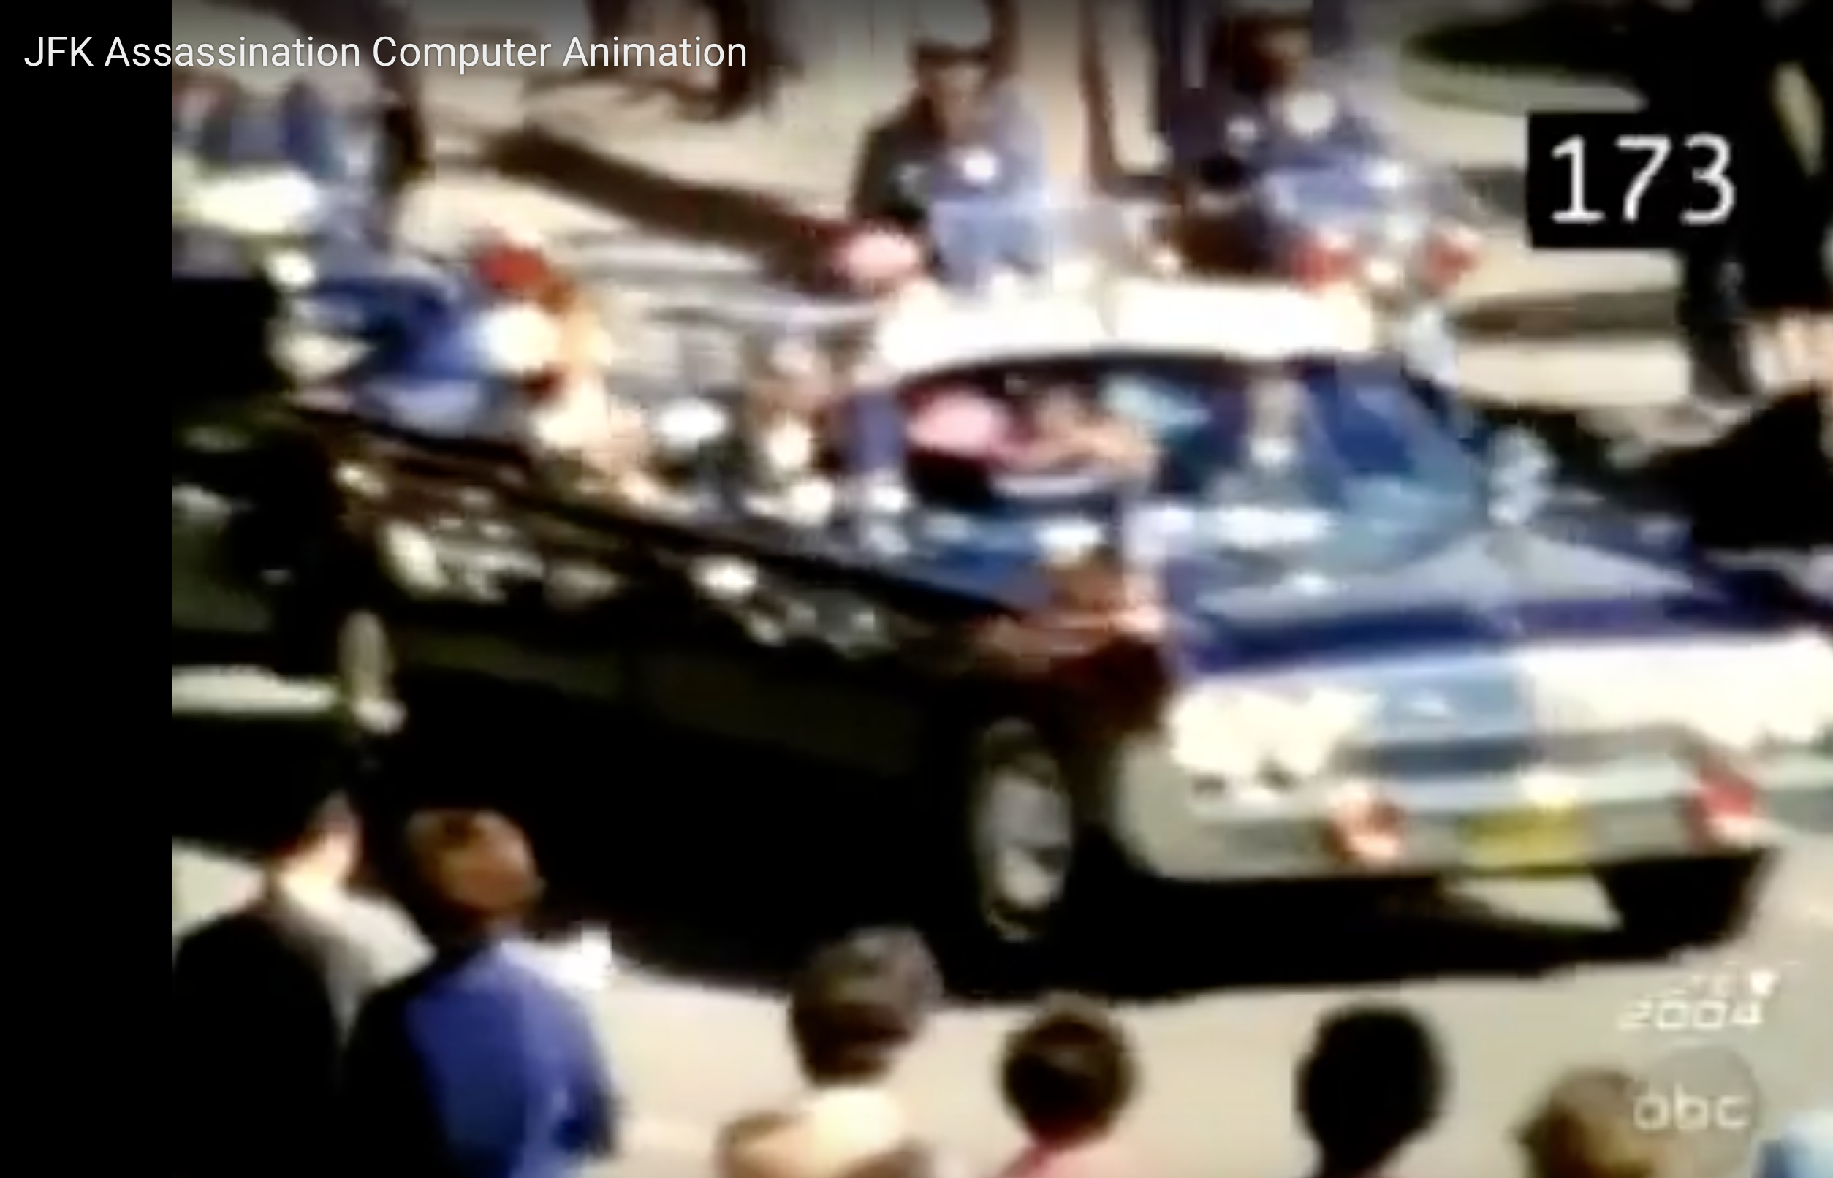
Notes:
https://www.youtube.com/watch?v=PfSXkfV_mhA
https://www.youtube.com/watch?v=iU83R7rpXQY

Slide 8
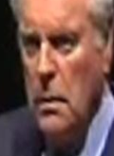

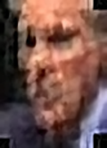
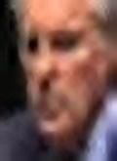

Slide 9
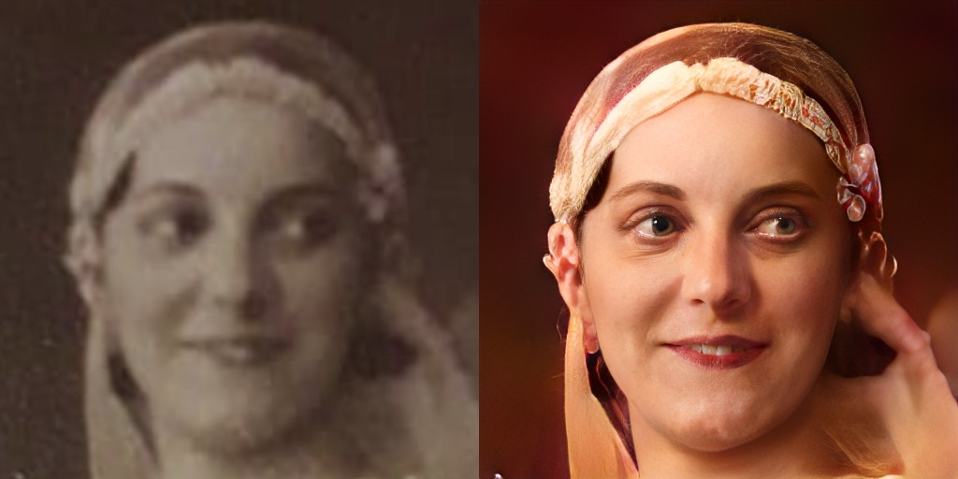

Slide 10
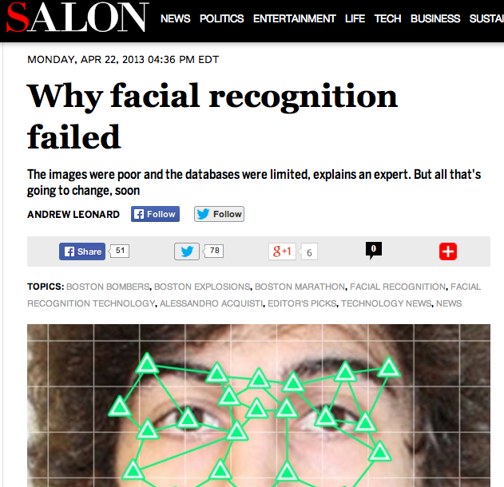
Notes:
Face recognition algorithms could not identify Boston bombing suspects

Slide 11
In contrast to conventional face recognition, unconstrained recognition involves matching a query image taken without the subject’s cooperation, and typically exhibits greater variations in confounding factors such as pose, illumination, expression, resolution, and occlusion.
J. C. Klontz and A. K. Jain (2013) A Case Study of Automated Face Recognition: The Boston Marathon Bombings Suspects, IEEE Computer.

Slide 12
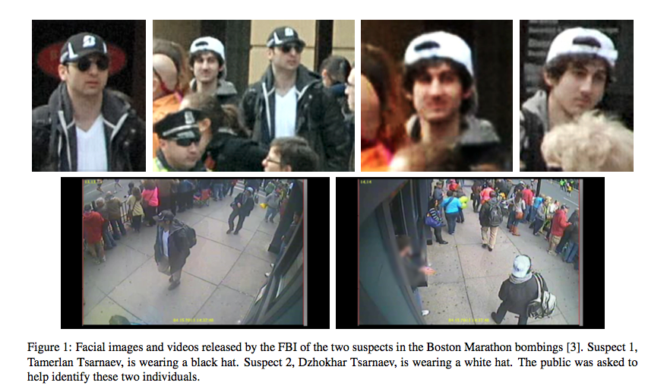

Slide 13
